Slide 1
Phylogenetics - thinking with trees
Philip Ashton

Slide 2



Anders Gonçalves da Silva, PhD MDU PHL --- Bioinformatics Team

Slide 3
Outline
What are trees?
How do we make a tree?
Topologies
Pairwise SNP distances
Bootstraps
The End
Timed phylogenies
Branch lengths
Models of sequence evolution and DNA substitutions
Recombination
Why would we use phylogenies in epidemiology?
Notes:
Too many things on here

Slide 4
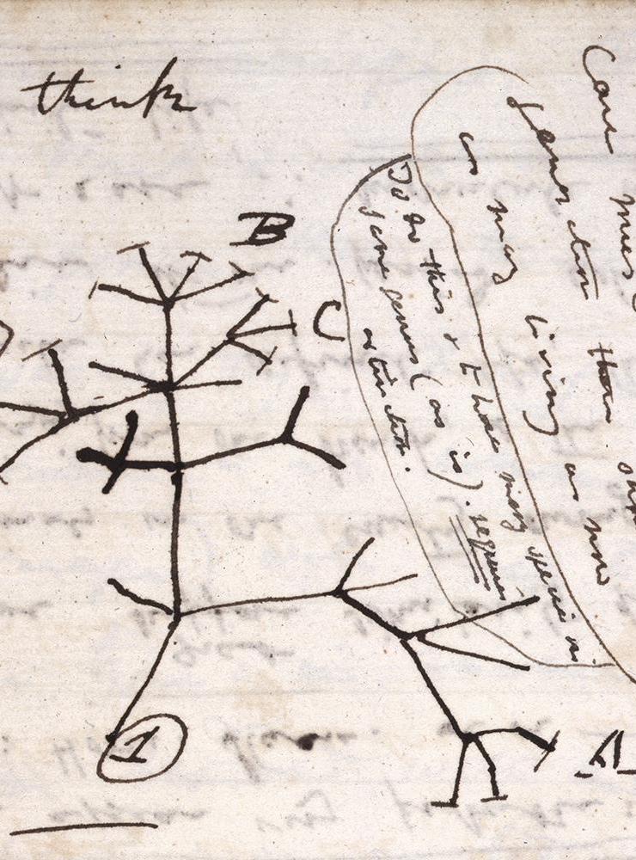
What are phylogenetic trees?
A graphical summary of the ancestral relationships between organisms
The reproductive links from individuals, to populations, to species, to all biological diversity
Notes:
They represent ancestral relationships --- they capture information about relatedness.

Slide 5
Hug et al., Nature Microbiology, 2016
Notes:
People use phylogenetic trees to study a whole range of different timescales. Here we have an image from a very nice paper which used metagenomics to propose the existence of this candidate phyla radiation.
For context, all the eukaryotes, plants, animals, parasites etc are all down here.

Slide 6
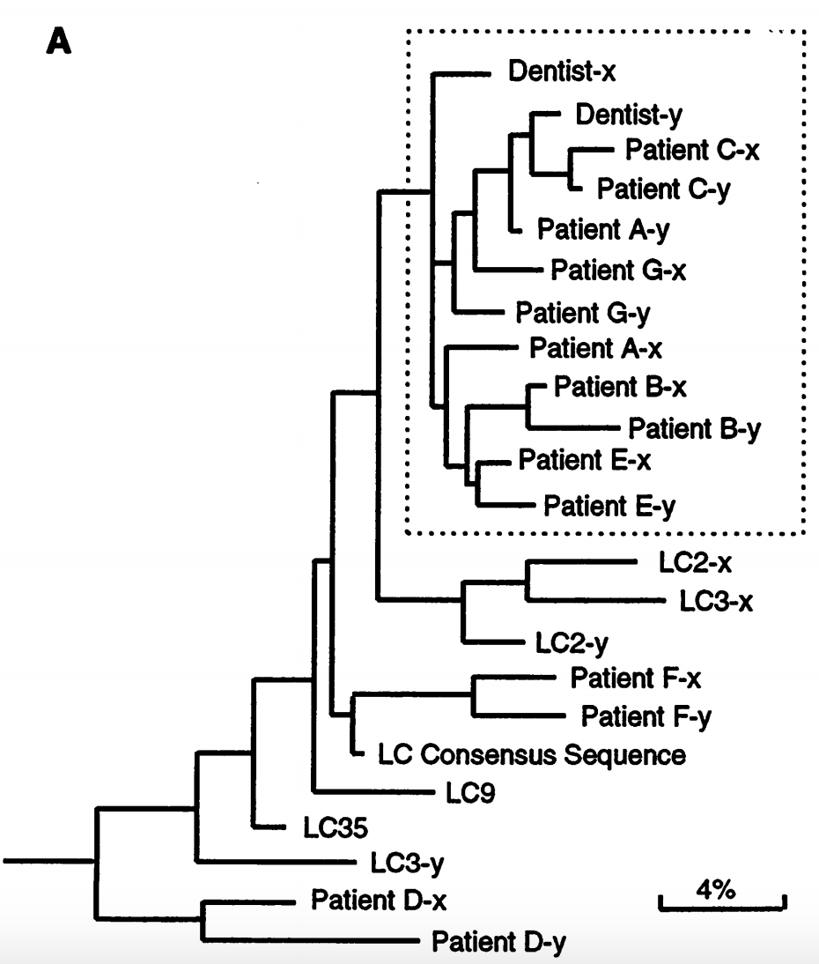
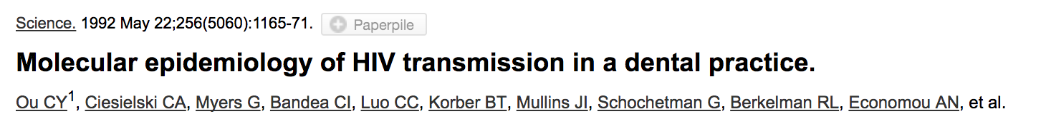
Why would we use phylogenies in epidemiology?
Phylogenies help reduce epi uncertainty.
Notes:
However, people also use phylogenetic trees to study what some people would call micro-evolution. Very small changes between very closely related organisms.
For example, here is one of the first use of sequence data for molecular epidemiology in 1992. A dentist was implicated in the infection of his patients with HIV. The close phylogenetic relationship of the HIV from the dentist and his patients is strong evidence that there’s a link in their infections.
Introduce the basic terminology – tips, branches, how to read it etc

Slide 7
How do we make a tree?

Slide 8
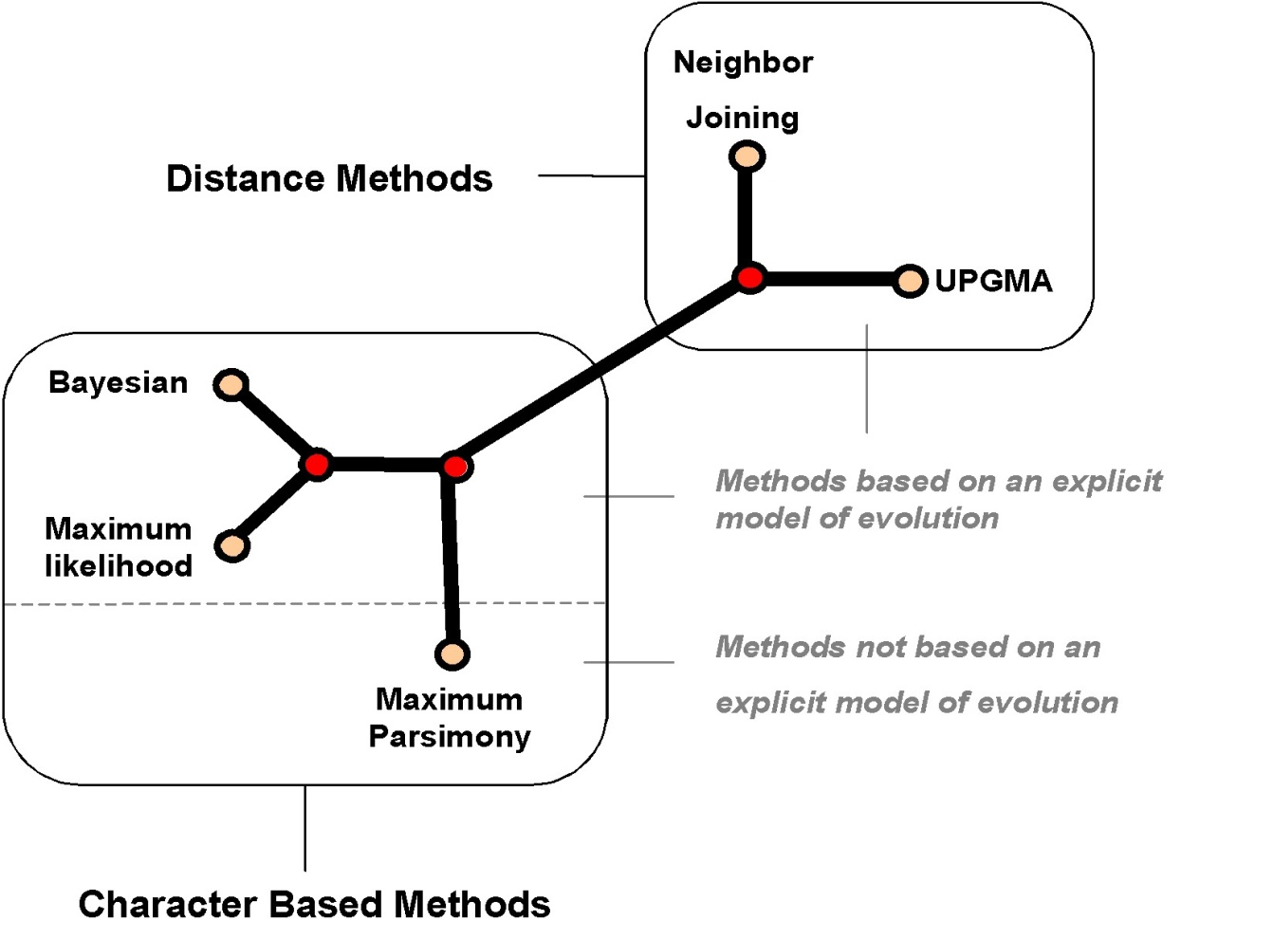

Slide 9
The maximum likelihood way
Data
Data
Usually sequence data
Can be physical features e.g. does it have a tail, etc.
Model
Assumes tree like evolution
Contains a few other key features we will go through
Model
Assess how well the model fits the data
(i.e. the ‘likelihood’)
Output – the maximum likelihood model

Slide 10
Number of tips | Number of Trees
3 | 3
4 | 15
5 | 105
10 | 34,459,425
20 | 8.200795e+21
30 | 4.951798e+38

Slide 11
Topologies

Slide 12
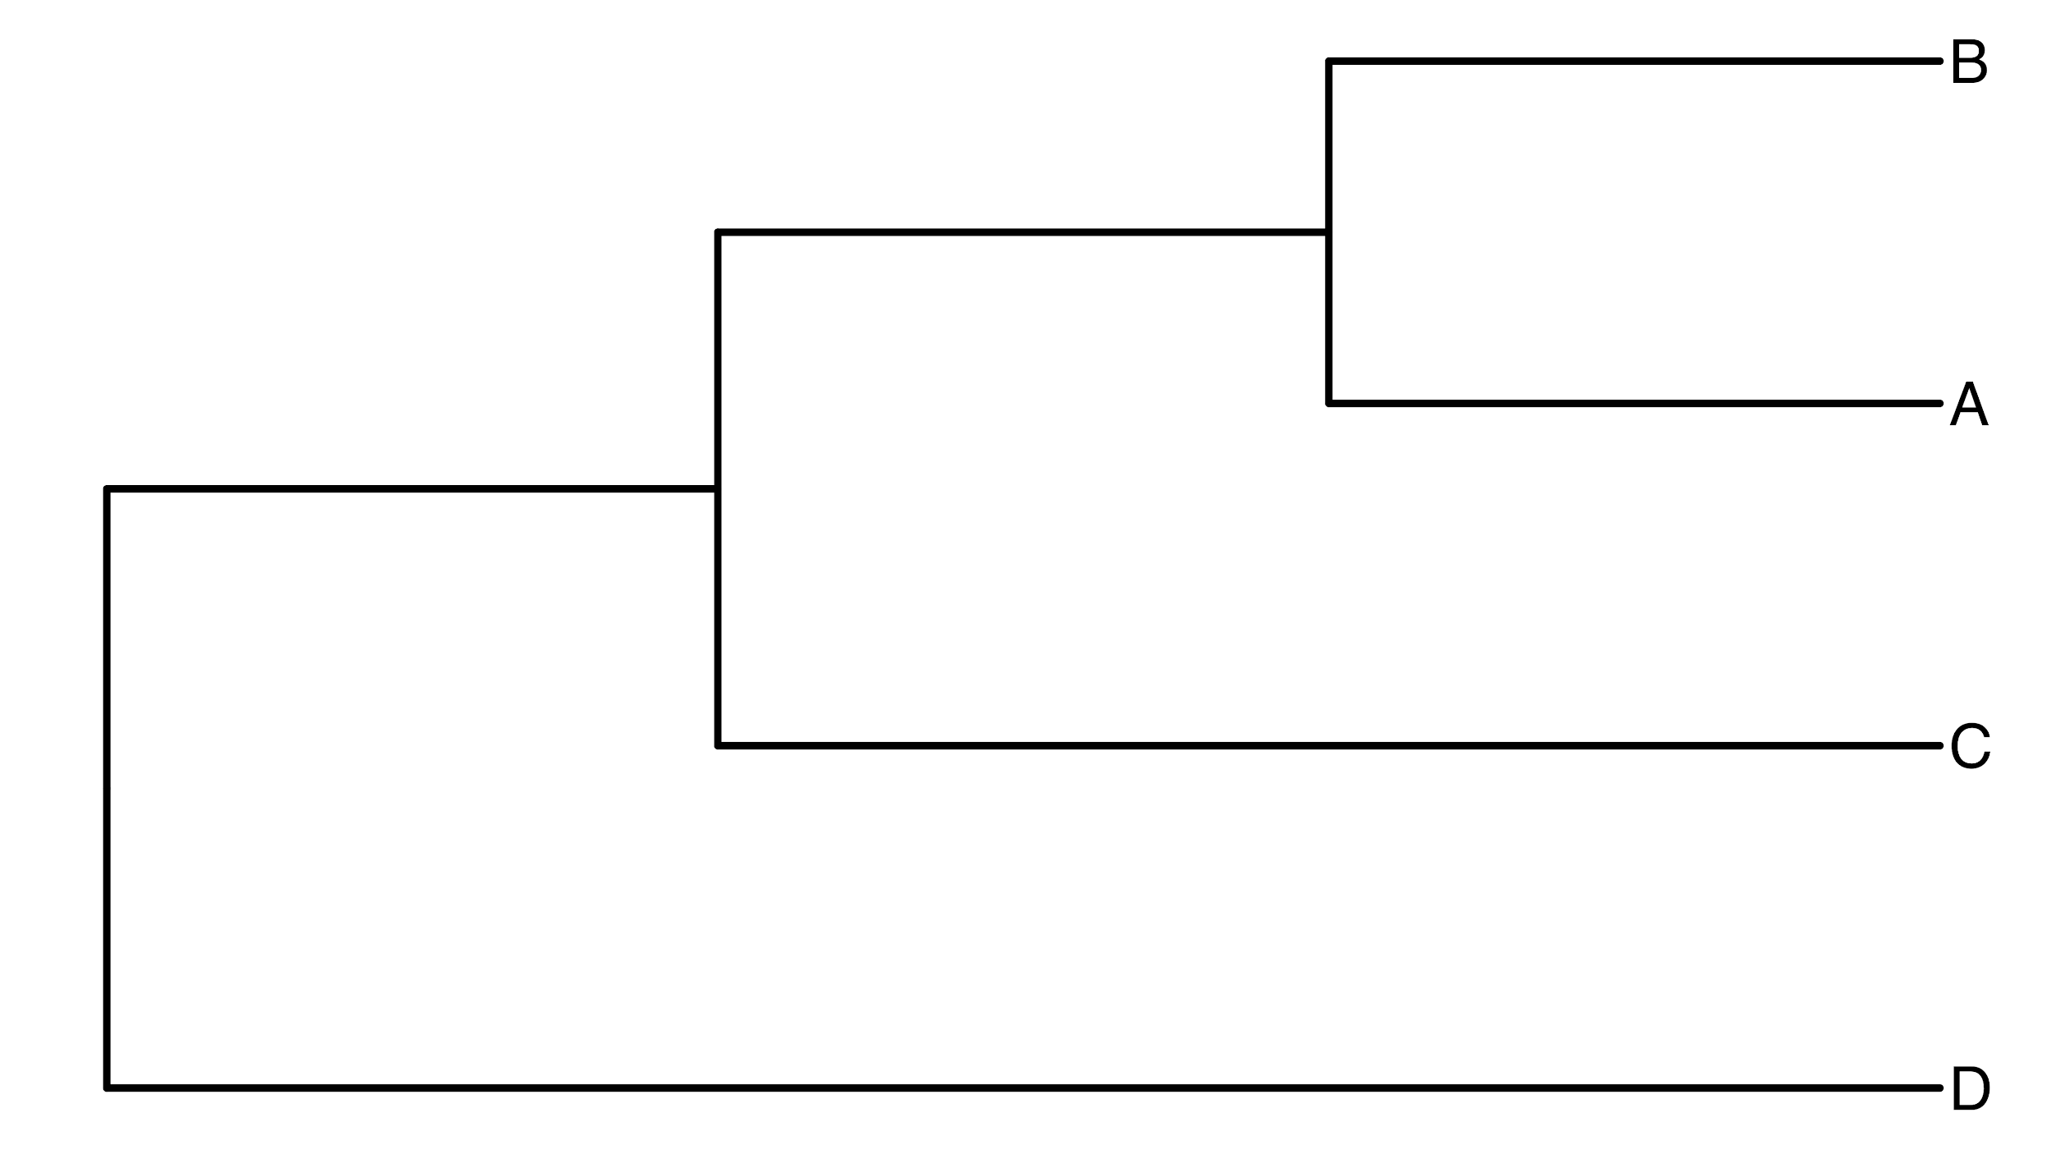
Anatomy of a tree (rooted cladogram)
Notes:
Speak to anders about this?
Different parts of the tree, tips, inferred ancestors, branches, MRCA, vertical branches for display

Slide 13
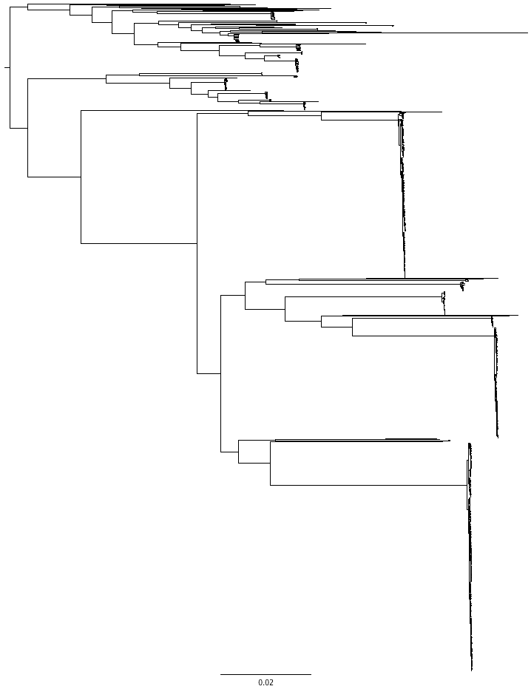
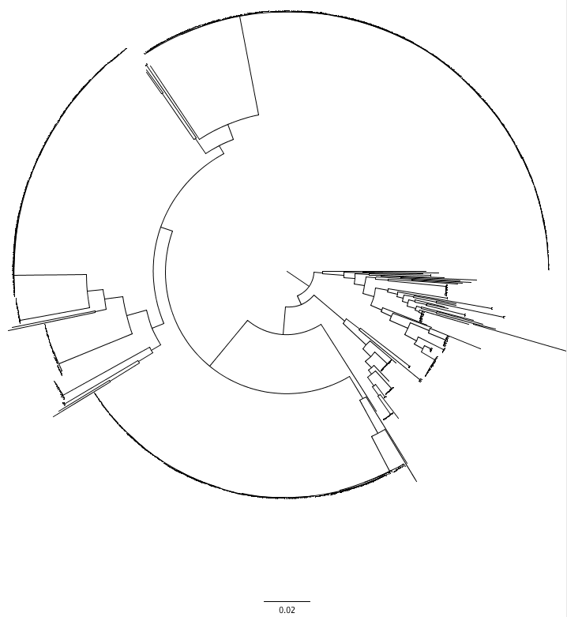
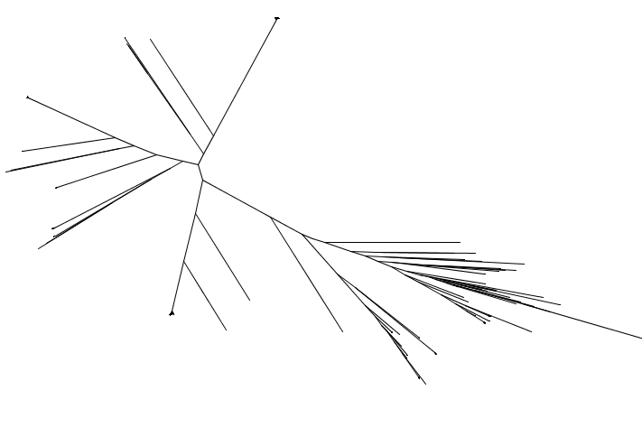

Notes:
The way in which trees are presented can be confusing. So here we have three trees which look quite different, but they are actually exactly the same tree in three different formats. We have rectangular, circular and unrooted. COmpare the three trees and show where they are similar.

Slide 14
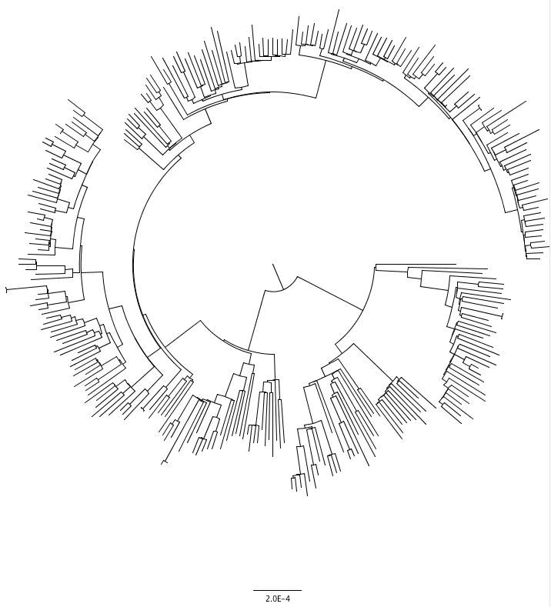
Notes:
You also need to be careful about the scale of trees. Not only the actual scale here, which can be a bit difficult to interpret, but you need to have an idea of the overall level of diversity encompassed in a tree.
For example, the tree on the right is data from within one of the big flat clades on the left. It looks ‘flat’ when viewed alongside other genomes which are dissimilar from it, but when we focus only on that clade it appears much more diverse. Exactly the same data, exactly the same diversity, just the representation is different.
When it’s a direct comparison between different parts of the same tree, like here, then the scale bar is useful. However, the scale bar is a little tricky to interpret, and we will cover that later.

Slide 15
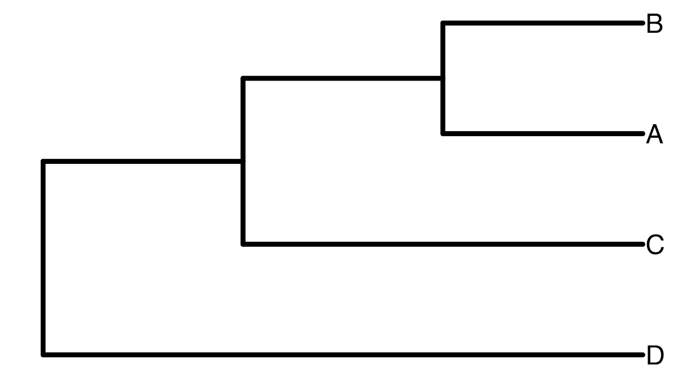
Additional representations: Newick Format
( ( ( B, A ), C ), D )

Slide 16
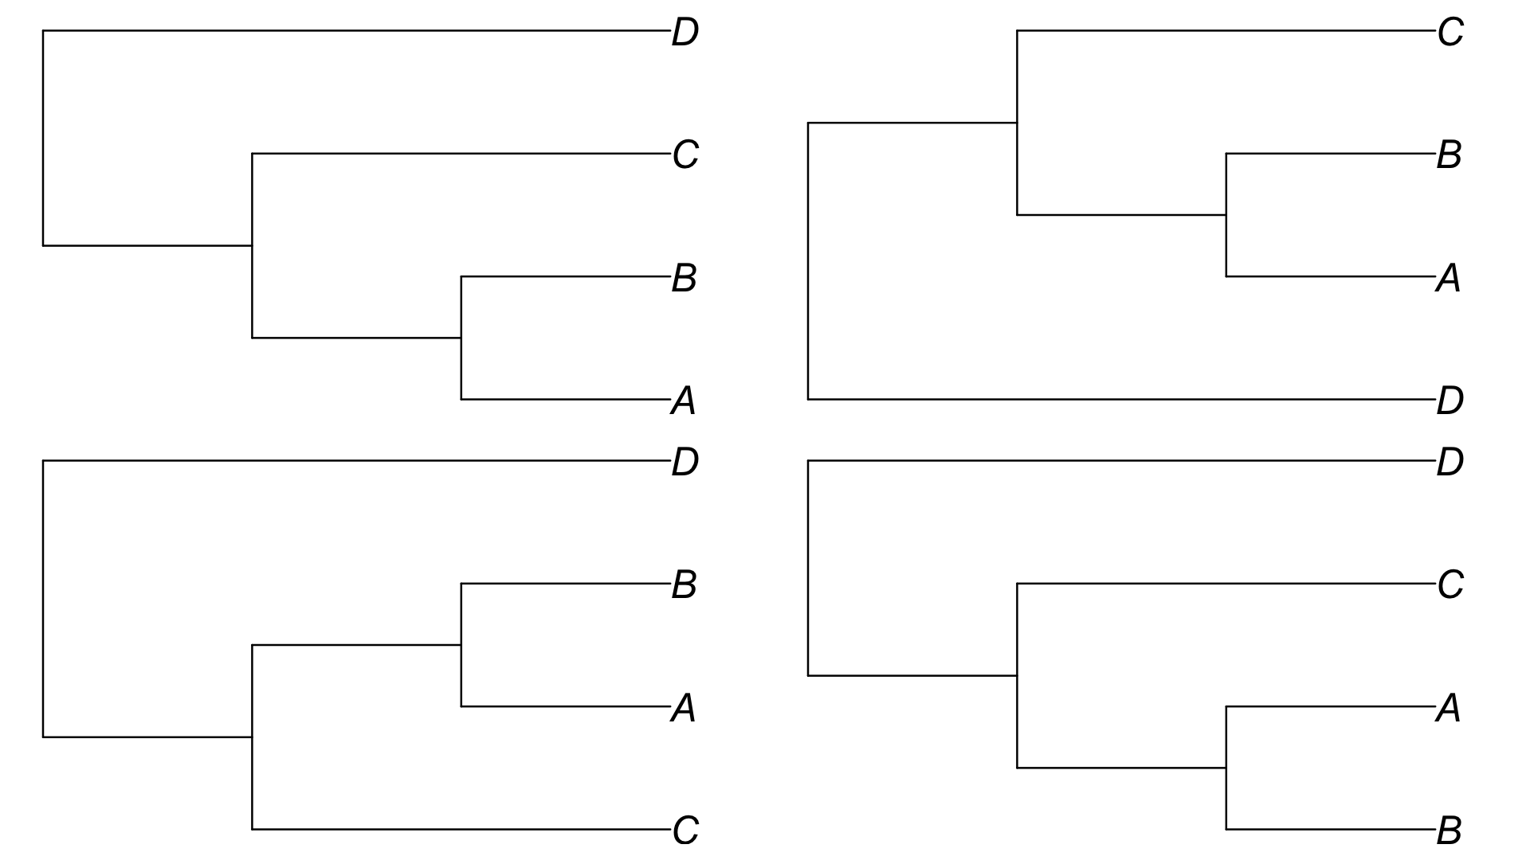

Slide 17
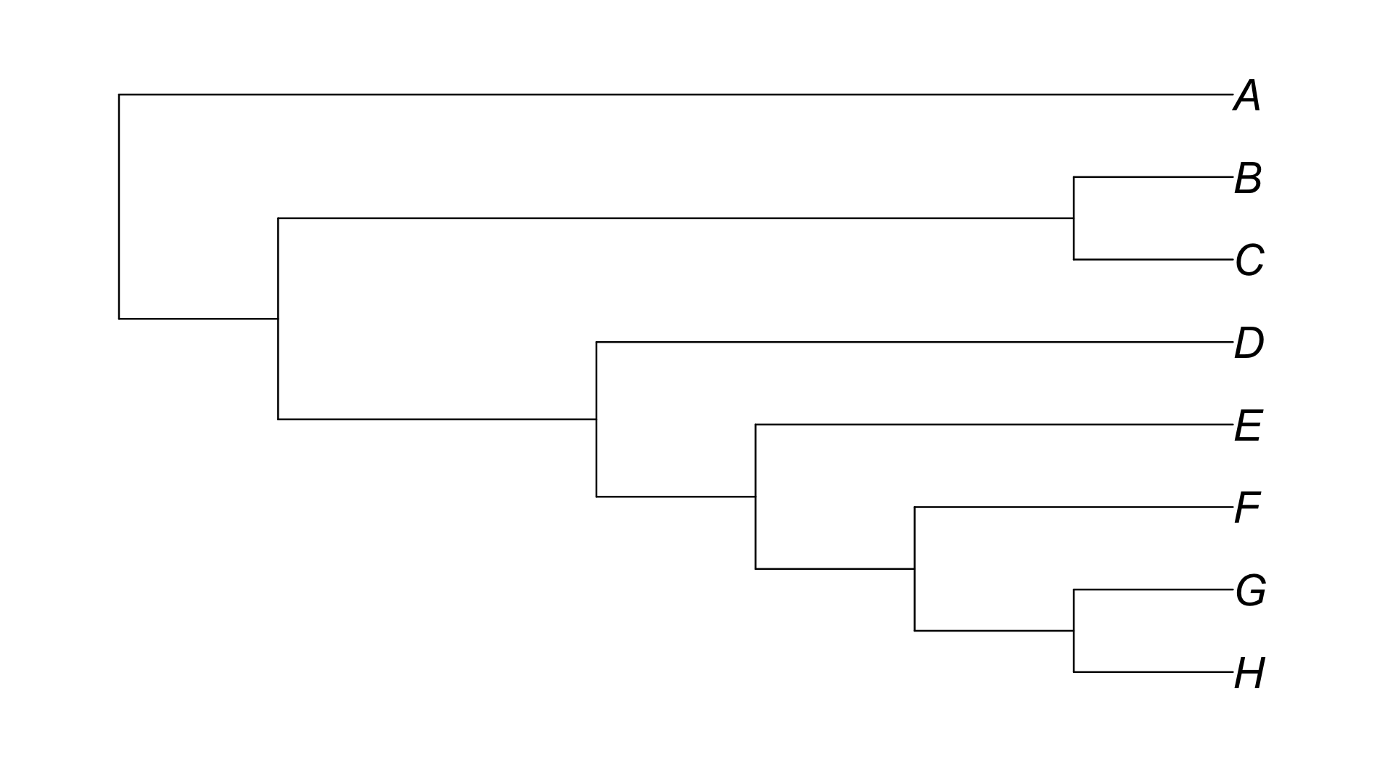
Is B closest to A or H?

Slide 18
Monophyletic clade: a group of genomes that consists of all the descendents of a common ancestor

Slide 19
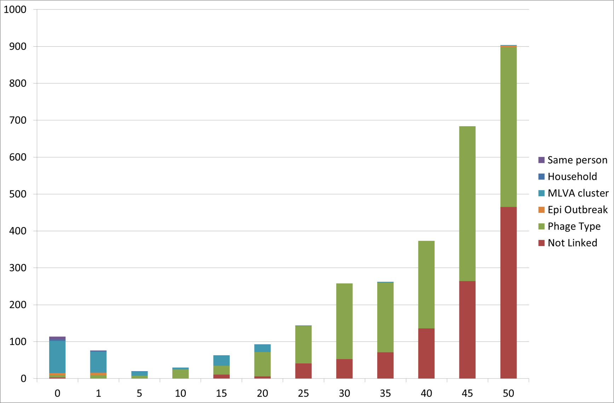
Pairwise SNP distance interpretation
Frequency
Shiga Toxin
producing E. coli O157
Pairwise SNP distance
Number of SNP differences
WGS for investigating E. coli O157 outbreaks

Slide 20
How to identify phylogenetic signal?
“tendency for related species (isolates) to resemble each other more than they resemble species drawn at random from the tree” - Blomberg and Garland, 2002
Notes:
Phylogenetic signal can be thought of as the ability to predict a trait given only the phylogenetic placement.

Slide 21
Bootstraps
1
1
X
1
1
1
X
1
60
X
X
X
2
2
X
2
X
2
X
2
2
40
X
80
3
X
3
X
3
3
X
3
X
3
4
4
4
X
4
4
4
5
X
5
5
5
5
X
5
60
X
X
X
60
6
X
6
X
6
X
6
X
6
X
6
7
7
7
7
7
7
A well predicted branch would recur >70-80 / 100 simulations
Notes:
Bootstrapping involves sampling a fraction of the alignment and recalculating the tree, this happens e.g. 100 times. Then, the tree made from all the data is compared to each of the bootstrapped trees. If the same splits occur in the bootstrapped tree, then the bootstrap supports that branch.

Slide 22
The End

Slide 23
Anatomy of a tree
Notes:
? Shared evolution and independent evolution?
Inferred common ancestor

Slide 24
Common mistakes and how to avoid them
Common mistakes
Looking along the tips --- order is arbitrary (remember rotations)
Counting nodes
Perceived notions of relationship
Avoid them by
Sign-post method
Grouping method

Slide 25
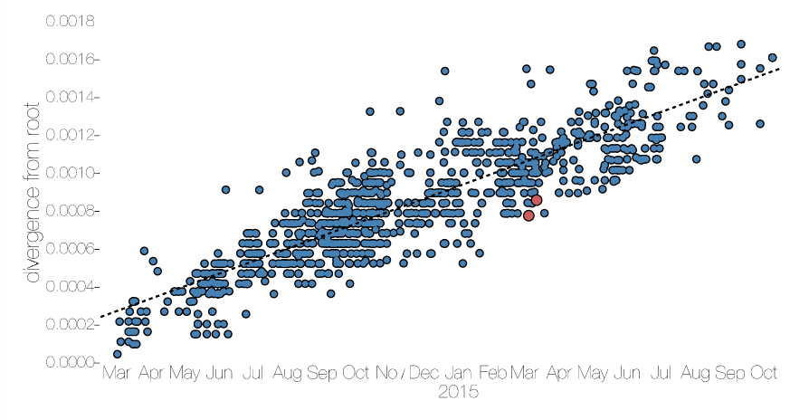
Timed phylogenies
BEAST is a commonly used tool for putting dates on phylogenies. However, it assumes that there is a molecular clock. Tempest, from Andy Rambaut can show you whether there is clock like evolution.
Tip date randomization is another method to identify clock-like evolution.
EBOV evolution - Eddie Holmes

Slide 26
Which split happened first?
Notes:
Timed phylogenies?

Slide 27
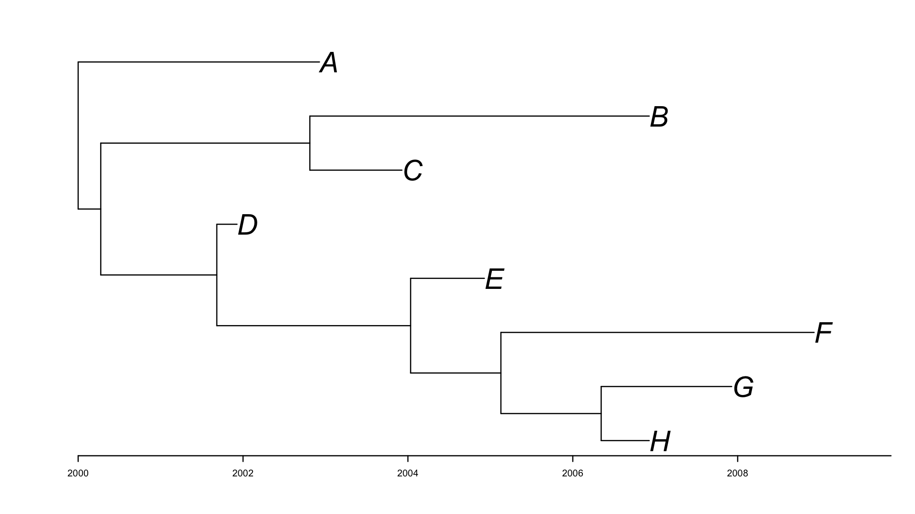
Notes:
Timed phylogenies?

Slide 28
Beyond topologies --- what are the branch lengths all about?

Slide 29
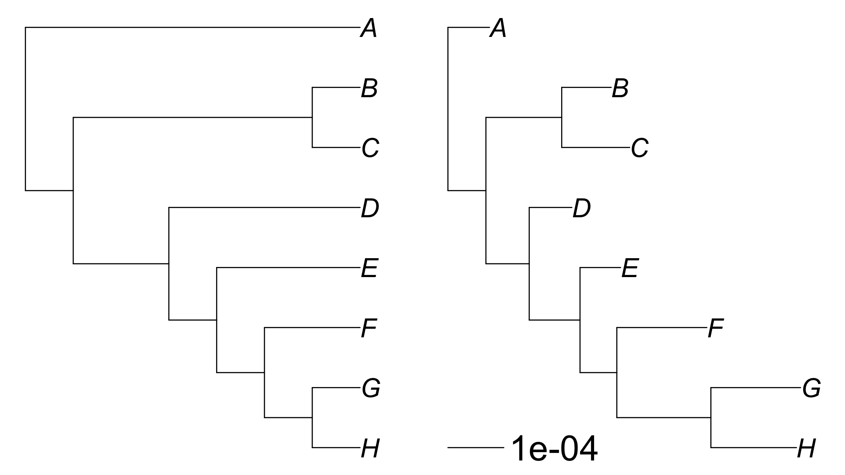
Cladogram
Phylogram

Slide 30
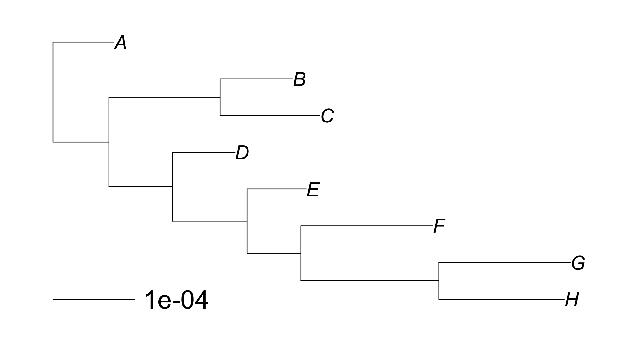
2.0e-0.4
0.8e-0.4
1.2e-0.4

Slide 31
Branch lengths
Depend on the evolutionary model
Gives the measure of the amount of evolution that has happened at a branch
In the case of maximum likelihood trees, they represent the expected (or average) number of substitutions along the branch
We sum branch lengths to measure the distance between pairs of nodes

Slide 32
Naive branch length to SNP calculation
Need:
Scale bar
Number of SNPs in the alignment
Total length of tree
Number of SNPs = (Distance on tree / total length of tree) * Number of SNPs in the alignment

Slide 33
Pairwise distances
Count of differences (i.e., pairwise SNPs)
Estimate of the number of substitution events
Parsimony
Maximum likelihood/Bayesian model

Slide 34
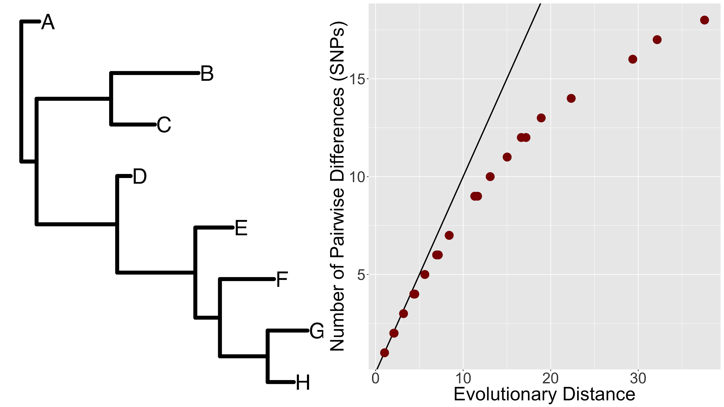
Not real data

Slide 35
What is happening?
Sequences are FINITE
Leads to MUTATION SATURATION
This means MULTIPLE HITS at a site
This means that OBSERVED PAIRWISE DIFFERENCES are likely an UNDERESTIMATE of the total divergence

Slide 36
Models of evolution
Parsimony
Goal: minimise the number of steps
DNA or Amino acid substitution models
Goal: Correct the observed differences pairwise differences --- or estimate the actual number of substitutions that have actually happened
Underpins most modern tree inference software

Slide 37
What is a SUBSTITUTION?
A T G G C T A A T G C G C
A T G G C T G A T G C G C

Slide 38
Loads of mathematics!!
(https://en.wikipedia.org/wiki/Substitution_model)

Slide 39
But, let us get a gut feeling for the process!

Slide 40
A T G G C T A A T G C G C
A
C
G
T
Prob(SUBSTITUTION)

Slide 41
Common parameters in substitution models
Base frequencies
Transition/Transversion ratio
Gamma distributed among site rate heterogeneity
Proportion of invariant sites

Slide 42
Jukes-Cantor 1969 (JC69)
Assumptions
All BASE FREQUENCIES are the same:
A = T = C = G = 0.25
A SINGLE SUBSTITUTION RATE
A
C
G
T

Slide 43
Kimura 1980 or Kimura-2-Parameter (K80)
Assumptions
All BASE FREQUENCIES are the same:
A = T = C = G = 0.25
Allows for unequal transition/transversion ratio
Transition:
A <> G or C <> T
Transversions:
The rest
A
C
G
T
A T G G C T A A T G C G C

Slide 44
Generalised Time Reversible (GTR)
Assumptions
BASE FREQUENCIES are different:
A ≠ T ≠ C ≠ G
Allows for individual substitution rates
A
C
G
T

Slide 45
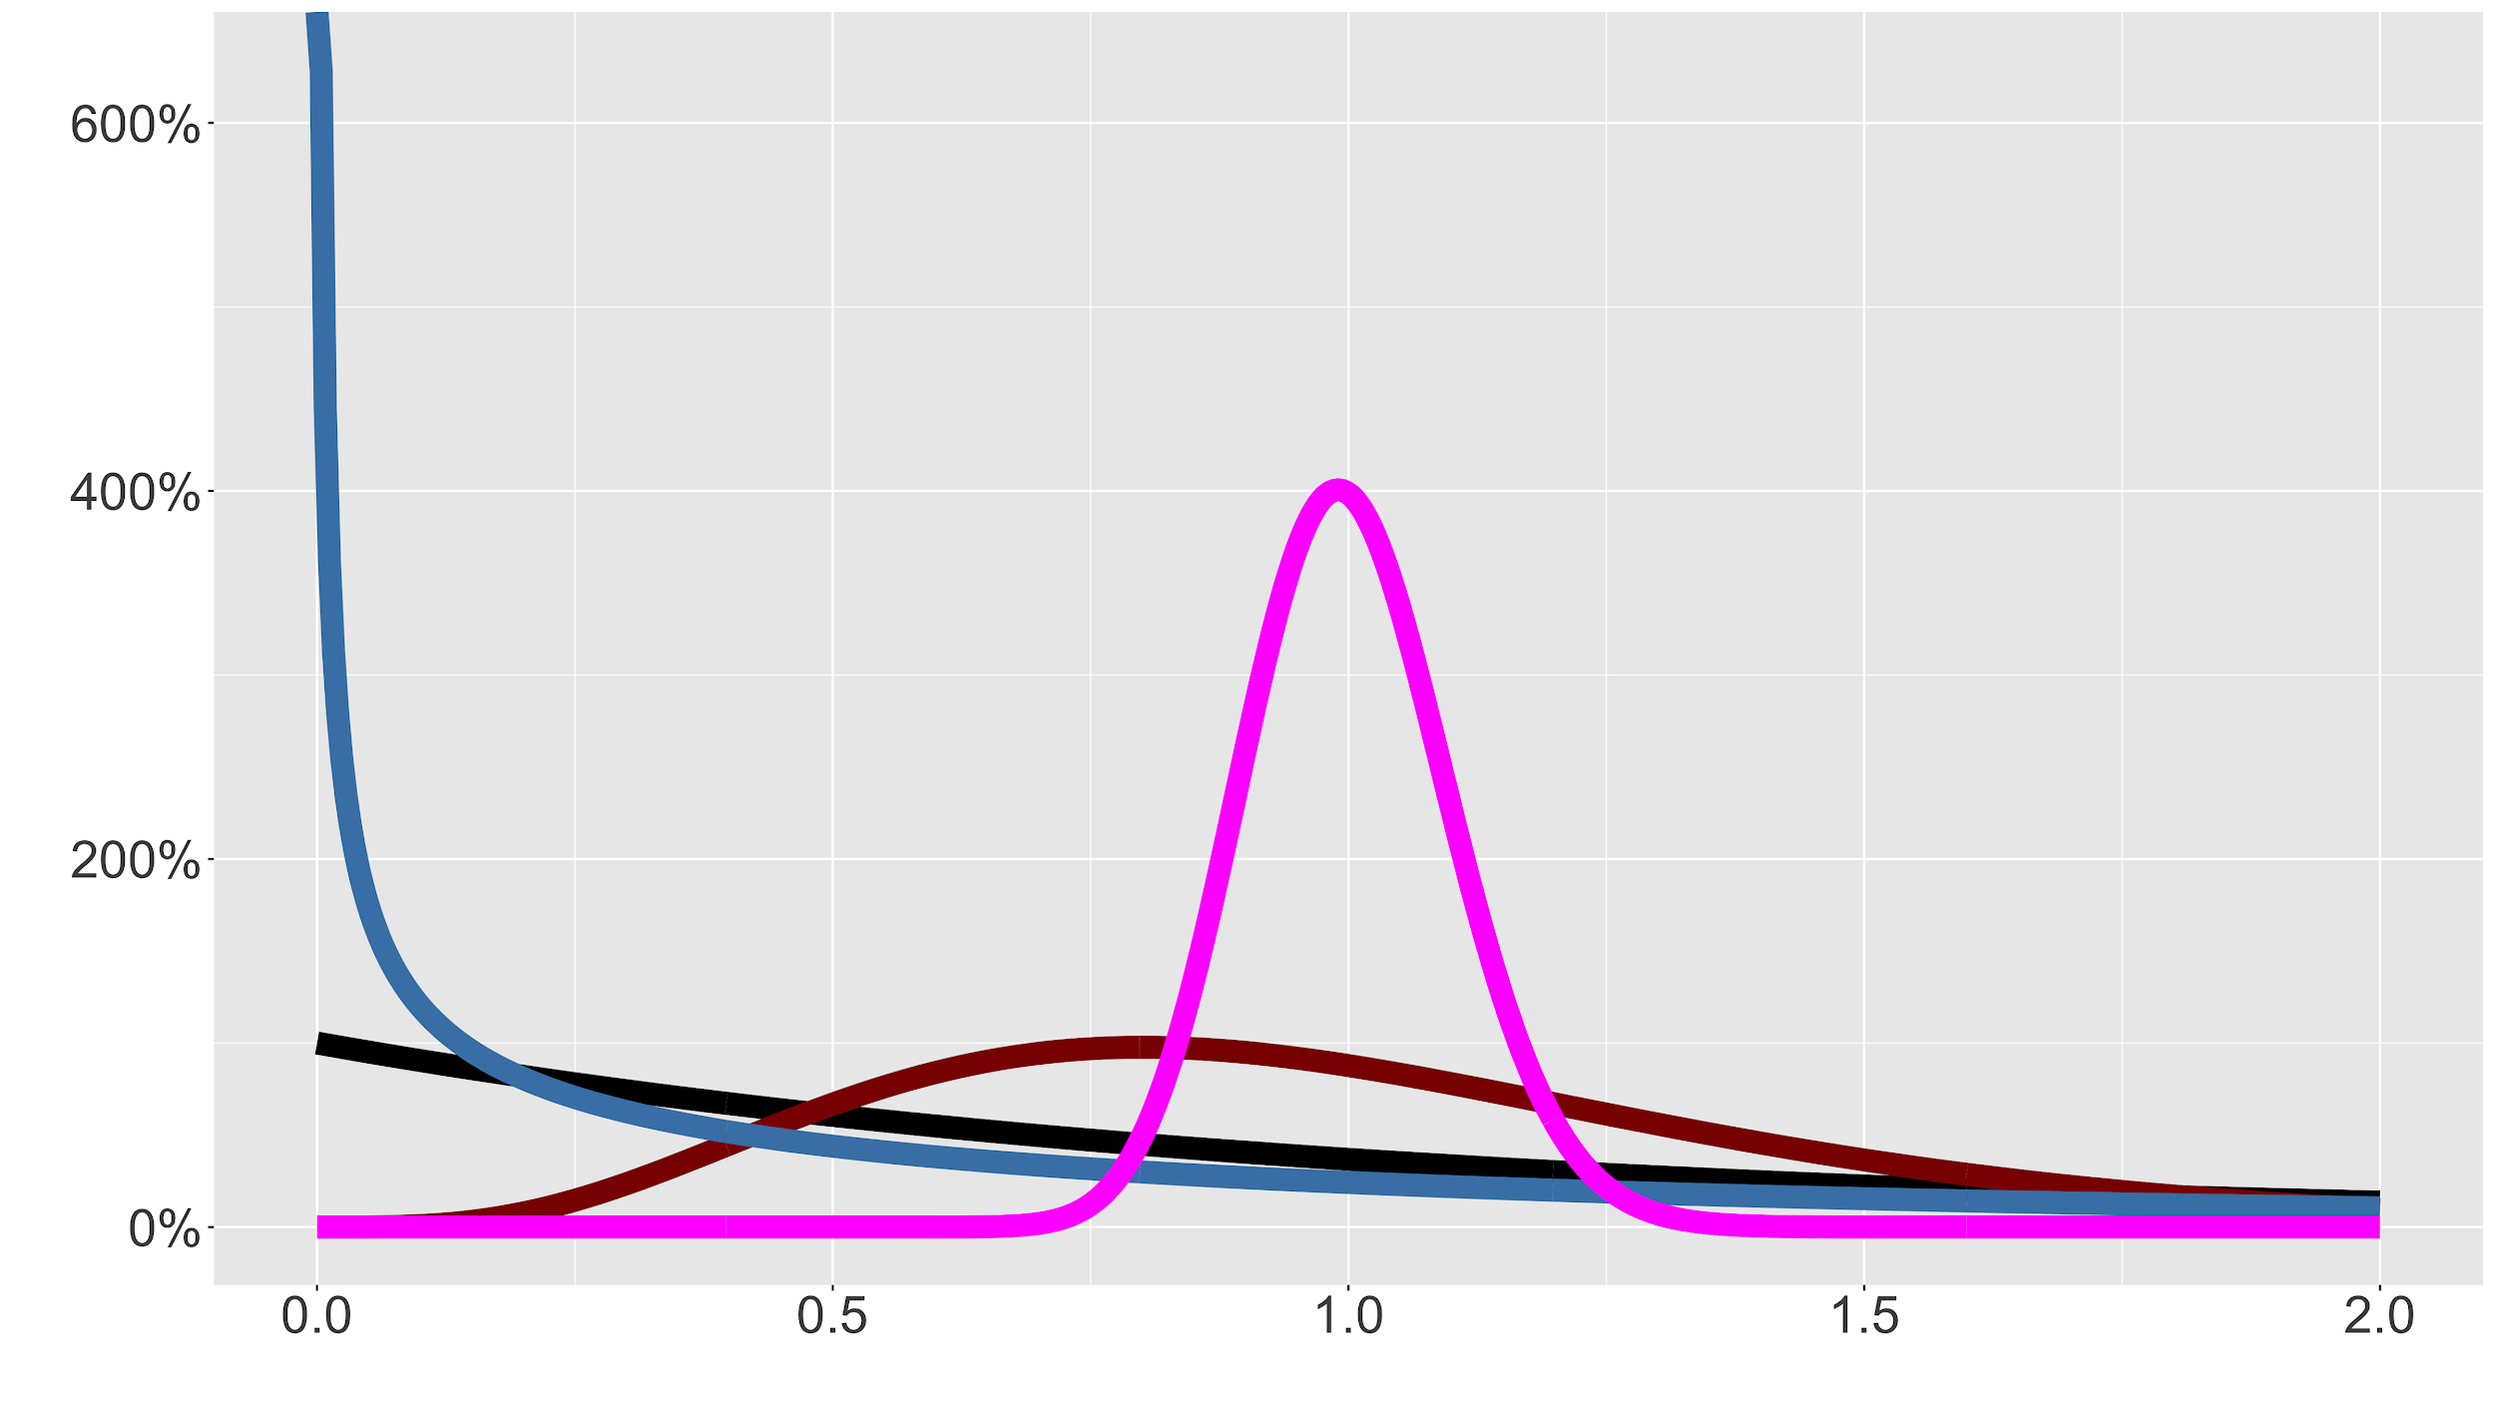
Among site rate heterogeneity (Γ)

Slide 46
Proportion Invariant Sites (I)

Slide 47
GTR + Γ + I

Slide 48
Pairwise SNP distance calculation
 | Strain1 | Strain2 | Strain3 | Strain4 | Strain5 | Strain6 | Strain7 | Strain8 | Strain9
Strain1 | 0 | 161 | 136 | 134 | 118 | 192 | 104 | 110 | 195
Strain2 | 161 | 0 | 107 | 105 | 89 | 99 | 79 | 81 | 102
Strain3 | 136 | 107 | 0 | 68 | 52 | 138 | 54 | 44 | 141
Strain4 | 134 | 105 | 68 | 0 | 34 | 136 | 52 | 26 | 139
Strain5 | 118 | 89 | 52 | 34 | 0 | 120 | 36 | 8 | 123
Strain6 | 192 | 99 | 138 | 136 | 120 | 0 | 110 | 112 | 9
Strain7 | 104 | 79 | 54 | 52 | 36 | 110 | 0 | 28 | 113
Strain8 | 110 | 81 | 44 | 26 | 8 | 112 | 28 | 0 | 115
Strain9 | 195 | 102 | 141 | 139 | 123 | 9 | 113 | 115 | 0

Slide 49
Recombination

Slide 50
How clonal are bacterial populations?
Clonal – acquired DNA vertically from parent without recombination (sexual or otherwise)
Most phylogenetic trees assume that DNA has been transmitted vertically (no recombination)
Some bacteria undergo a lot of recombination, others are very clonal. Smith, JM et al., 1993, PNAS, v90, p4384
We can use Gubbins or ClonalFrameML to identify regions of recombination.
Can use a phylogenetic network approach (SplitsTree) to analyse your data
You need to know for your bacterium if it is recombinogenic or not, and what the best ways to deal with that level of recombination are
Mobile elements like phage and plasmids should usually be excluded, or treated separately in a phylogenetic analysis

Slide 51
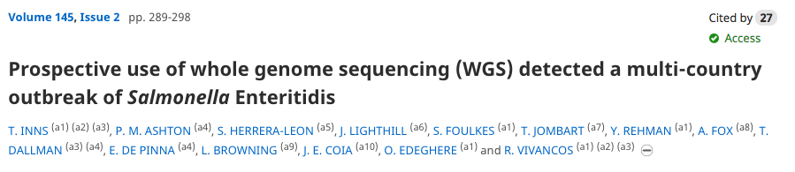
Why would we use phylogenies in epidemiology?

